Slide 1


2017
Lighting and the Tasking Environment

Slide 2
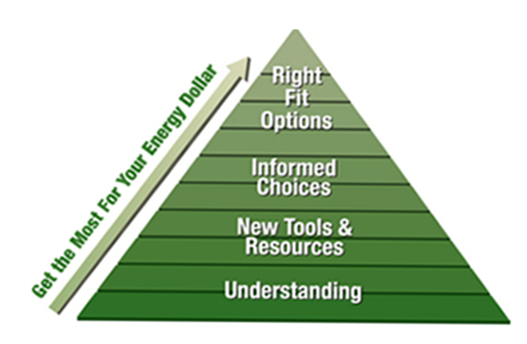

Right results, the Right way.

Slide 3





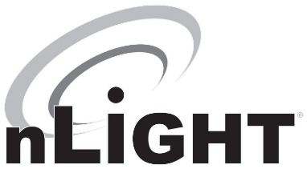
Brandon Smith, LC
Brandon Smith, LC
Senior Factory Sales, Acuity Brands
18+ Years Experience
Lighting Certified (LC)
Past President of the Illuminating Engineering Society of NA – Minneapolis
Acuity Brands is a leading manufacturer of energy efficient lighting fixtures, controls and systems for historically styled outdoor lighting, utility, roadway, industrial, and commercial markets.

Slide 4

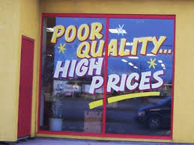

Compromises
Notes:
LED’s are the great equalizer. Every manufacturer can purchase the same LED’s, the same drivers. It’s up to us to determine the level of quality to put in to a product, and the amount of quality to take out of a product.

Slide 5
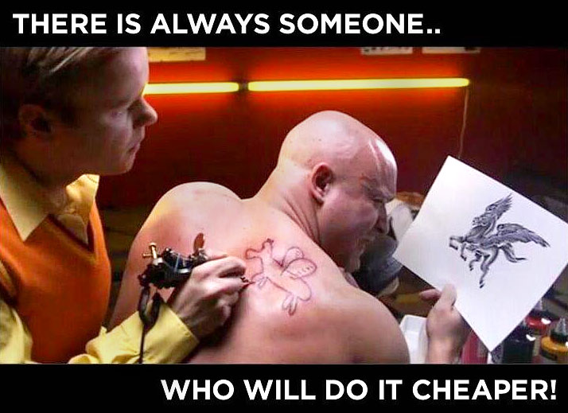
Notes:
While overwhelmed with information, don’t give up and make cost your sole decision criteria. Look for design assistance from MN Power

Slide 6
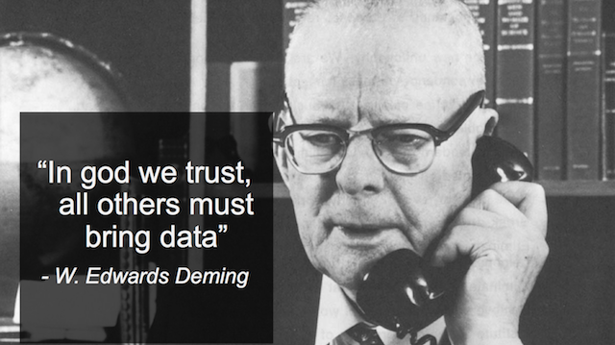





Lots of information on LED’s is available
TM-21
Notes:
More than any lighting technology, LED’s have lots of data available. Manufacturers Data sheets, NCQLP, photometry. It’s all available IF YOU ASK.

Slide 7

Death by data…
But it’s important to analyze.
Notes:
The internet has enabled accessibility to more information than ever before, but is it good information?
It’s not uncommon to find 10pages of data on one model of LED Luminaire. Use it to determine the exact configuration you need to meet your goals.

Slide 8

Navigating the Specification Space
What to consider:
What are your Lighting Objectives?
Lumen Output: Initial vs. Maintained?
Luminaire Construction
Thermal Limitations?
Color temperature (CCT) / (CRI)
Visual Comfort / Glare
Ease of Installation / Ease of Maintenance
Lighting Controls
Notes:
Here’s what I going to cover:
Why are you lighting the space?
What will it look like over time? How do you know?
Which style of light do you need?
What are these things?
Can it be controlled?

Slide 9
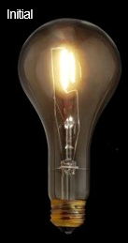
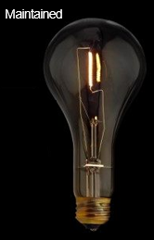
Initial Maintained
Initial Light Output
Maintained Light Output
Lamp Lumen Depreciation (LLD)
Luminaire Dirt Depreciation (LDD)
Luminaire Ambient Temperature (LAT)
Notes:
As you can imagine, nothing stays new forever.
These things are industry accepted depreciation factors used in determining how a light will fare in the future.
As with anything, good information up front yields more accurate results+

Slide 10
Appropriate Lumen Output
Notes:
1 model of light, 7 lumen output selections, 10 optical distributions, 4 color temperatures, 3 CRI choices. LOTS OF OPTIONS. Ask for help in selecting…

Slide 11
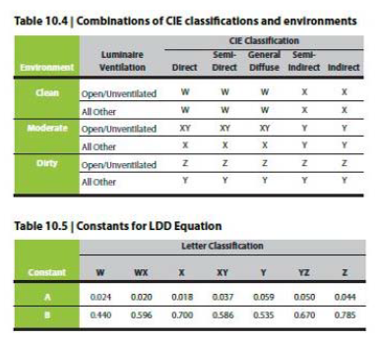
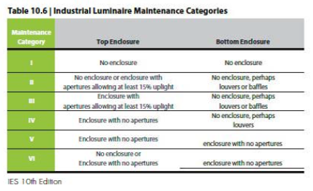
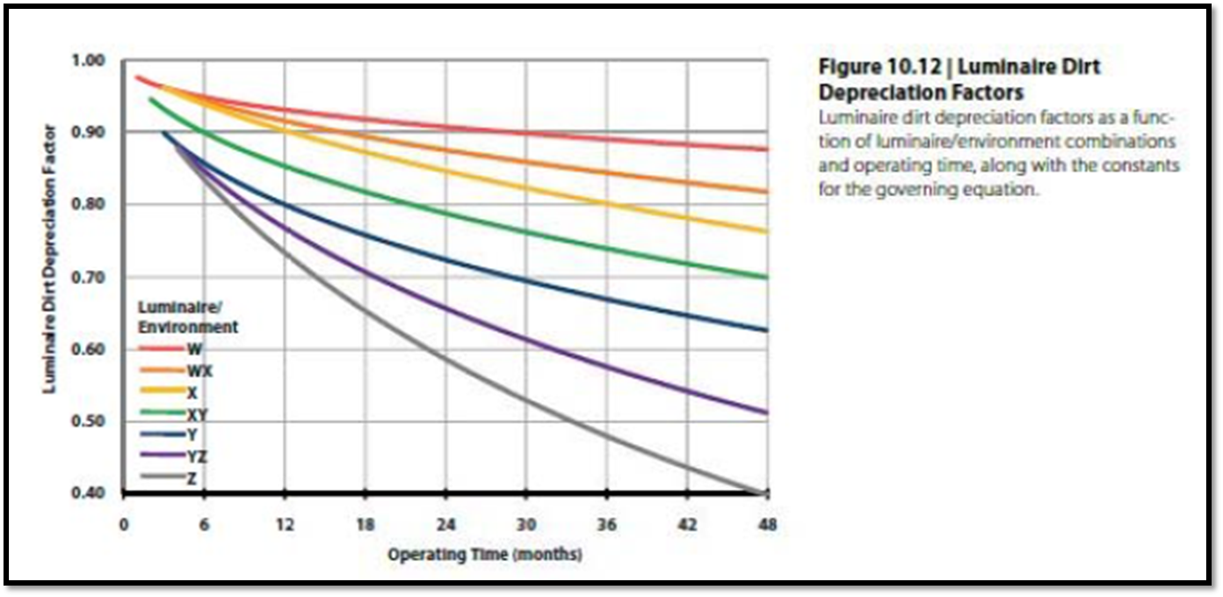
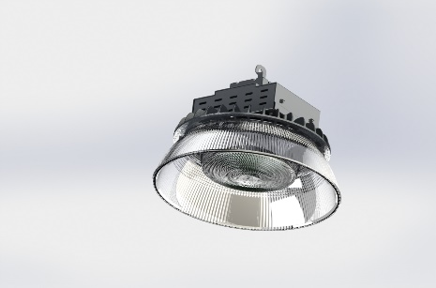
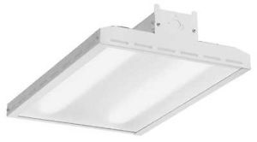
Luminaire Dirt Depreciation
Notes:
To determine LDD, we’re given charts from the IES. Luminaire construction has a large impact on how well it will product light and for how long.

Slide 12
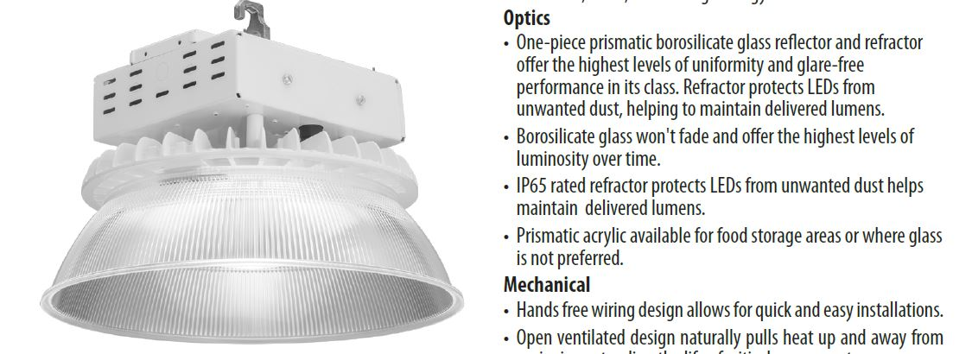
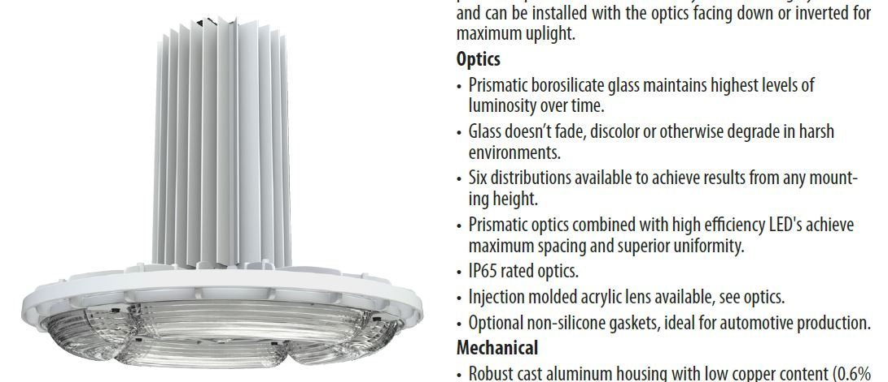
Luminaire Construction
Both have IP65 Rated Optics
Notes:
Both luminaires have IP rated optics. Is that enough for your application? Completely different applications (and costs)

Slide 13
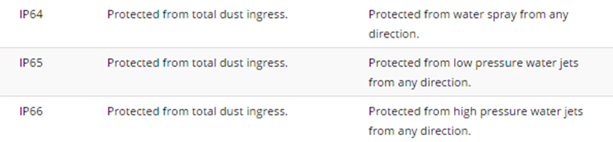
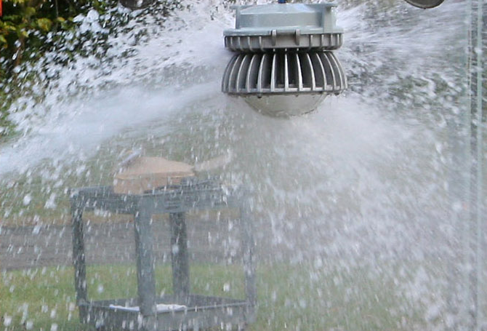
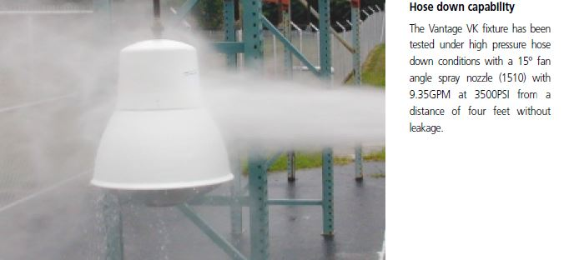
Ingress Protection (IP)
Notes:
First character is solids (6 = dust tight), 2nd liquids (5 water, 6 powerful water jets), SOMETIMES IP66 isn’t enough

Slide 14
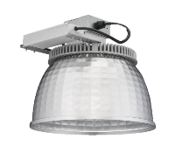
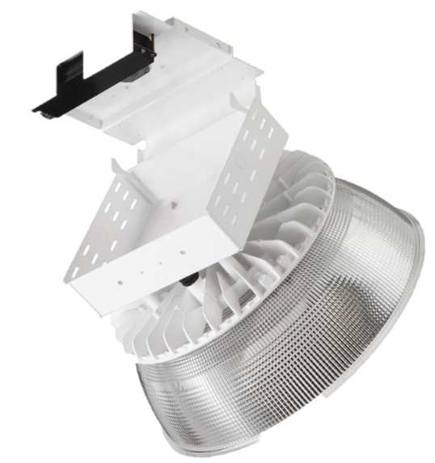
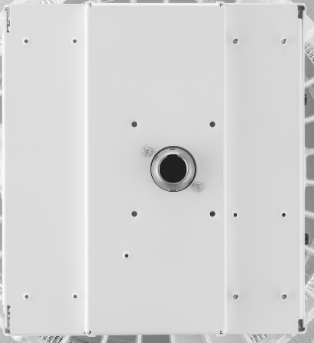
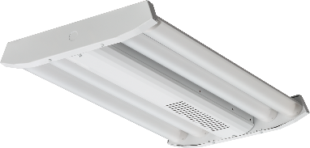

Commercial-Grade Luminaires
Hmmm?
Vented Housing
Large Area for Dirt Accumulation
on top of Housing
Holes on Top of Housing
Large Area for
Dirt Accumulation
Internal to the Luminaire
Notes:
Car washes, C-store, or warehouse. Not every luminaire can accomplish everything.

Slide 15
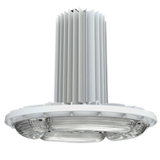
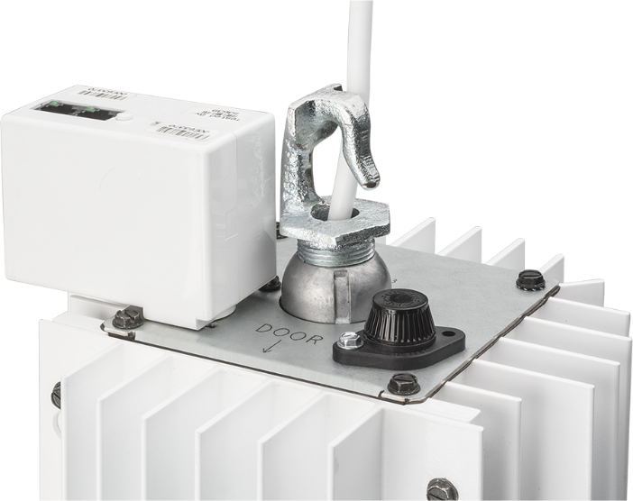
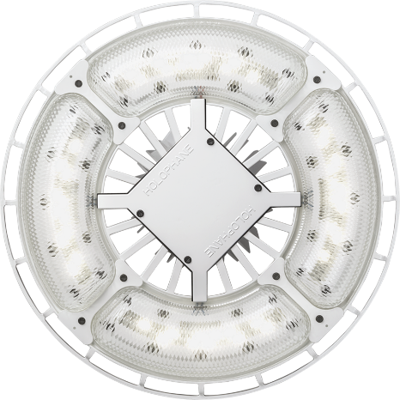
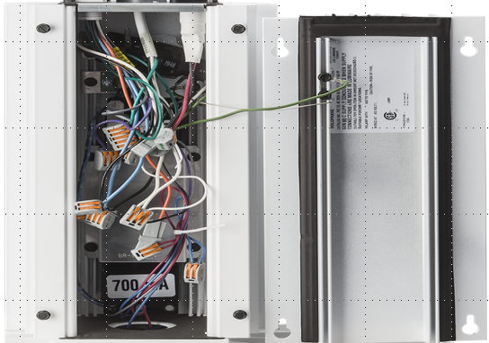
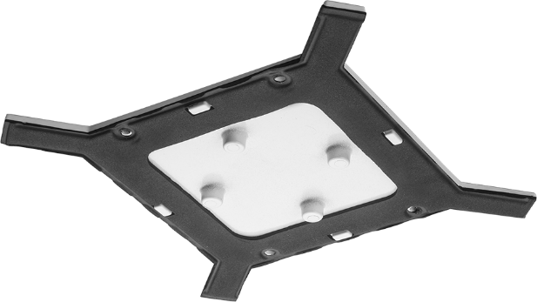
Industrial LED Construction
Cast Aluminum Housing
Glass Lens
Solid top plate
Gasketed optical assembly
Gasketed door
Gasketed housing
Notes:
Gasketing was added to better seal this style of luminaire. This type of luminaire may not be stocked on a distributors shelf but may be worth the 10 day lead time wait.

Slide 16
Mechanical Design
Steel or Aluminum Housings
IP Rating
Dedicated Heat Sink –
  LED Life Rating (measured by Lxx)
Paint Finish, Testing Parameters:
  Meets 1000-hour Salt Fog Testing
Vibration Rated
  ANSI Testing (i.e 1.5g)
Temperature Ratings Range: -40°C to 65°C
Surge Protection? (driver enough or supplemental)
Notes:
When a company designs a luminaire, these are some of the choices they need to make. As you can imagine, each comes with costs associated.

Slide 17

Is More Actually Less?
Option A
40c Standard (55c option)
22,390lm @ 55c
50k hrs L70 @ 55c
Driver 100k hrs @ 40c
Driver 30k hrs @ 55c
Option B
45c Standard (55c option)
20,600lm @ 55c
100k hrs L70 @ 55c
Driver 100k hrs @ 45c
Driver 50k hrs @ 55c
Notes:
Left slide has higher lm output but components don’t last as long. Manufacturers make trade offs all the time. ** This won’t be found on the cut sheet

Slide 18
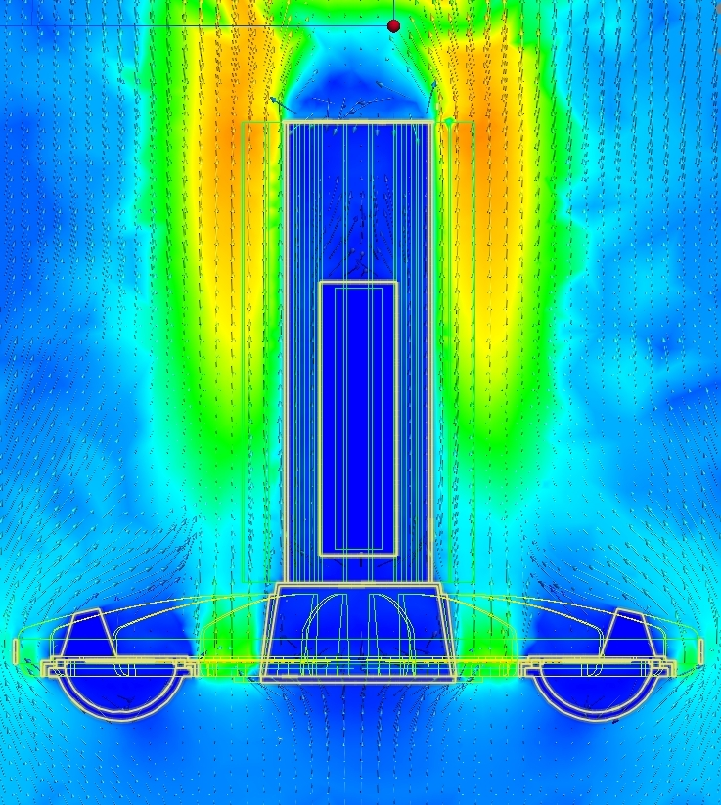
HEAT
Ambient Temperature versus Performance
LED: LED’s generate less lumen output as temperature increases.
Driver: Life is impacted if temperatures exceed cast temperature rating.
Note: Shown as (LAT) or
Luminaire Ambient Temperature Factors on manufacturer’s specification sheets
Notes:
We know LED’s generate a lot of heat, but how does that impact a luminaire and its’ performance?

Slide 19
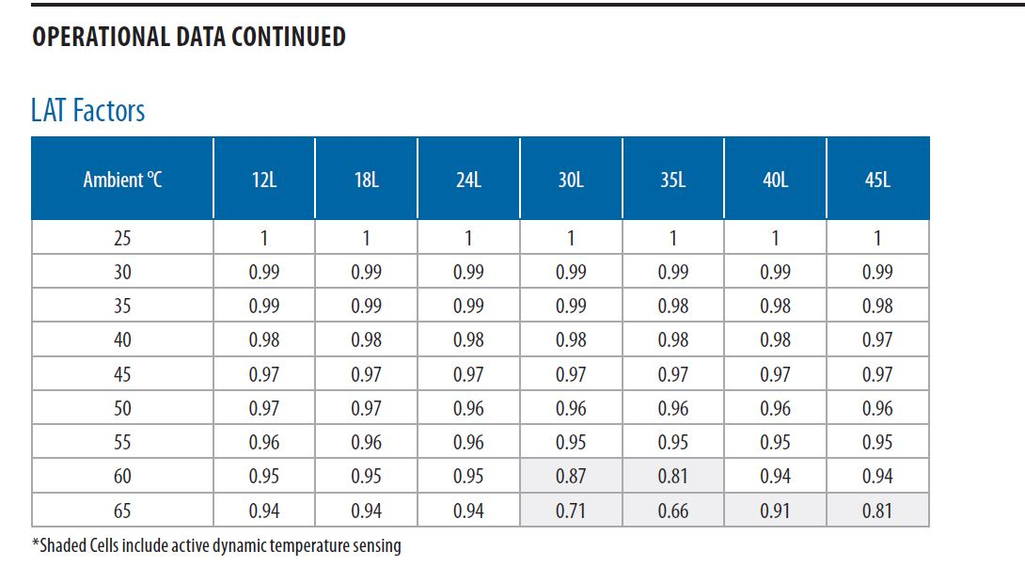
LAT FACTORS
(LAT) Luminaire Ambient Temperature Factors
Thermal Fold-back active
Notes:
As it gets hotter, less light out of the luminaire. At certain temperatures, the LED driver will begin dimming itself to protect the components. This is reflected in the shaded area. Some luminaires can produce less than ½ their initial rated output in certain conditions.

Slide 20

Thermal Management -
Thermal Cutback Impacts Lumen Performance
A
B
 | Luminaire A 18,000L | Luminaire B 17,500L
Lumens at 25C | 18,428 | 17,500
Lumens at 40C | 18,198 | 16,275
Lumens at 55C | 17,875 | 11,500
Lumens at 65C | 15,135 | 8,100
Notes:
The reduction in lumens for A follows the LED thermal curve.
The reduction in lumens for B is a result of driver thermal cutback.
The numbers do not show LED thermal reduction (thermal droop) so actual output is even lower.

Slide 21
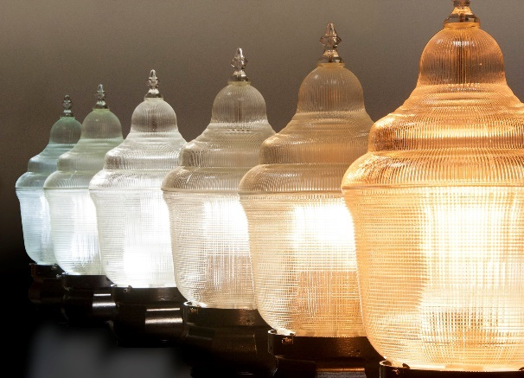
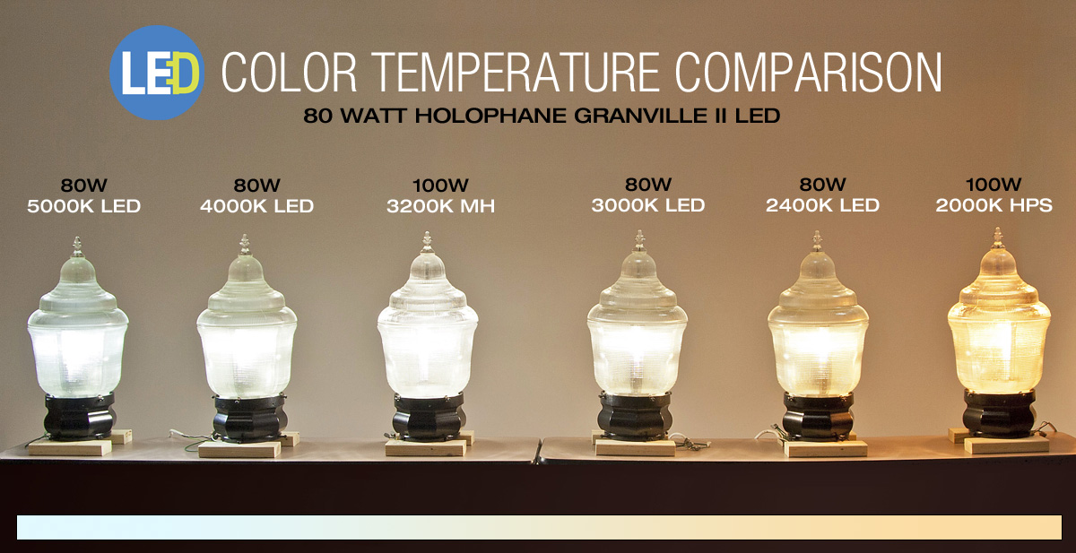
Correlated Color Temperature (CCT)
Cooler temperature (higher degrees Kelvin) appear more “Blue”.
Warmer temperature (lower degrees Kelvin) appear more “Yellow”
Notes:
In a well designed fixture, you can’t tell the source. These are the common CCT’s of different sources. LED can emulate any of them…

Slide 22
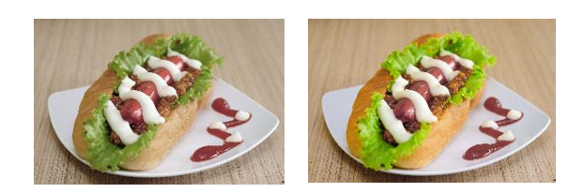
(CRI) Color Rendering Index
  High Color Rendition Index (CRI) allows colors to be more accurately perceived.
  90 CRI creates an enhanced visual experience which is particularly important in retail environments.
Source | CRI
High Pressure Sodium | 22
Metal Halide | 65-70
Traditional T12 | 60
Typical LED | 70
T8/T5HO | 80-85
LED optional | 80 (min)
LED Optional | 90 (min)
Sunlight | 100
80 CRI 90 CRI
70-80 CRI is ideal for most applications, but a 90 CRI option can be highly beneficial in retail applications.
Notes:
CRI- For most applications, 60-65 CRI was considered adequate. Today, you can get up to 90 CRI in LED, but there is a penalty in efficacy.
80CRI sample was too “yellow” due to better RED saturation. Higher isn’t better. Look at samples in your space.
Get MN Power involved early on the design side.

Slide 23
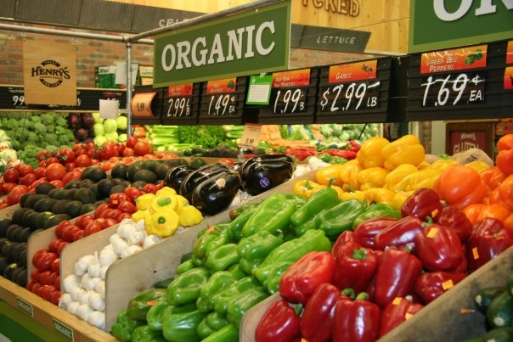
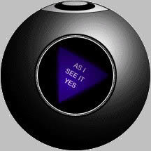
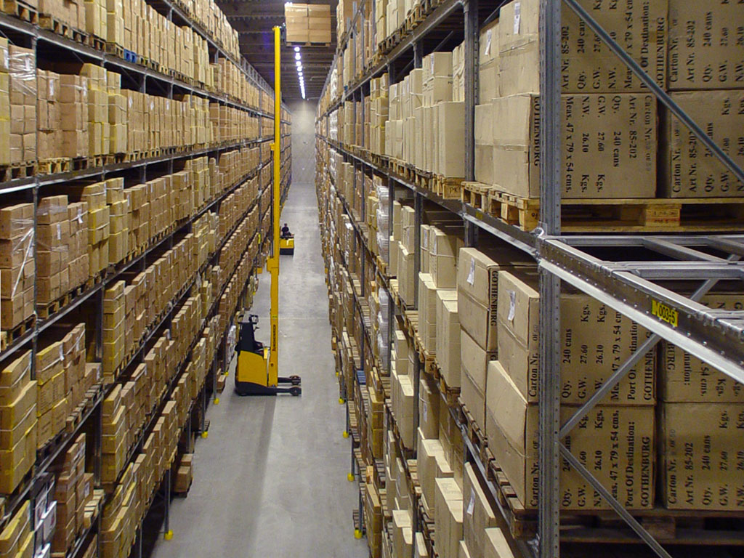
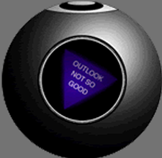
90 CRI?
Notes:
Know your application and the tradeoffs.

Slide 25
Color Temperature/ CRI Tradeoffs
CCT/CRI scaling
 | 3000K | 3500K | 4000K | 5000K
70 CRI | 0.93 | 0.96 | 1 | 1.01
80 CRI | 0.84 | 0.88 | 0.88 | 0.88
90 CRI | 0.61 | 0.64 | 0.67 | 0.70
Notes:
AS with anything, there are tradeoff’s. Look at the Penalty of 80 CRI is 12%,, 3k / 90CRI is 39% less than 4k / 70cri.

Slide 26
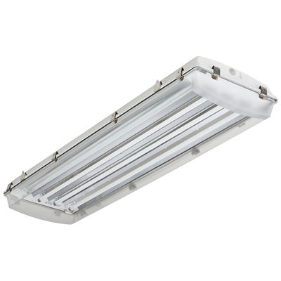




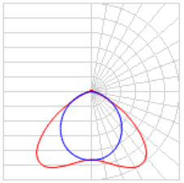
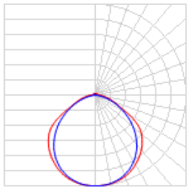
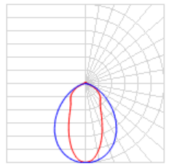
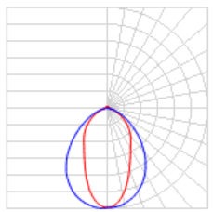
LED Luminaire Distributions
Wide
2.0 S/C
Medium
1.5 S/C
Narrow
1.2 S/C
Focus
0.9 S/C
Which one works best for your application?
Notes:
The optimal solution for your application may not reside in your distributor’s warehouse?

Slide 27
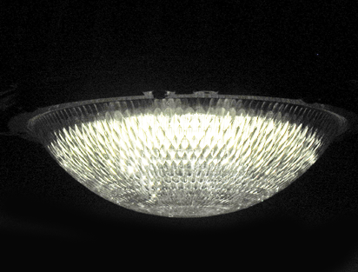
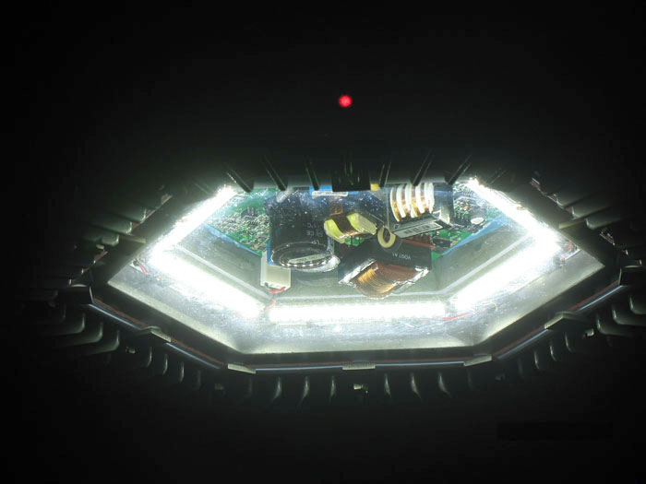
Optical Consideration– Glare
Glare can cause fatigue, result in low productivity, and impact safety.
Special considerations must be taken into account on how we control light into the space and onto the task.
Refractor
Bare LED’s
Notes:
LED’s produce a lot of lumens in a specific direction resulting in glare. In some applications it’s acceptable (LED freeway luminaire)

Slide 28
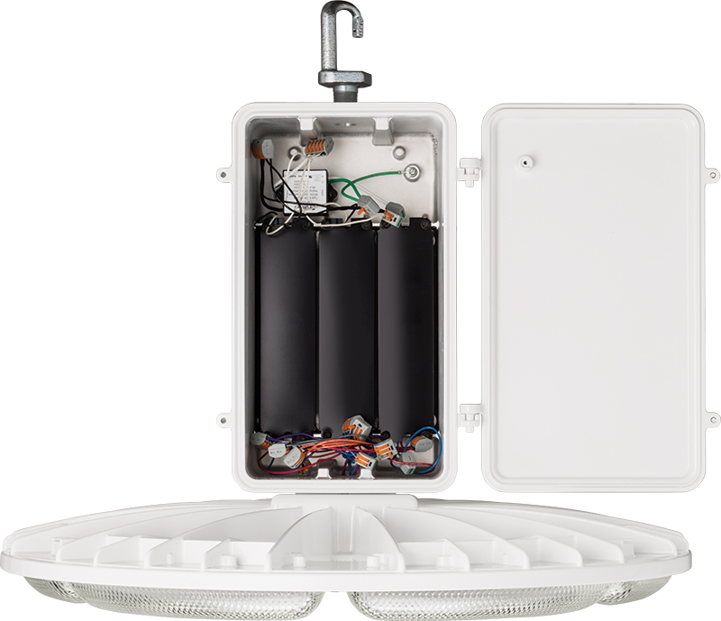
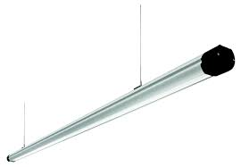
Ease of install / Maintenance
One or two points of suspension?
Are the luminaires in a straight line? More difficult with a square luminaire than round
Can you access the serviceable components?
Notes:
Beyond the initial install, how do you service the light? How does it hang? Are their provisions to make it look nice?

Slide 29
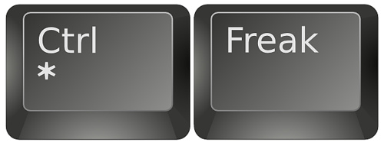
Sensors and Controls
Sensors & Controls
Notes:
LED’s naturally lend themselves to controls. Past technologies couldn’t be controlled cost effectively. 0-10vdc is the standard.

Slide 30
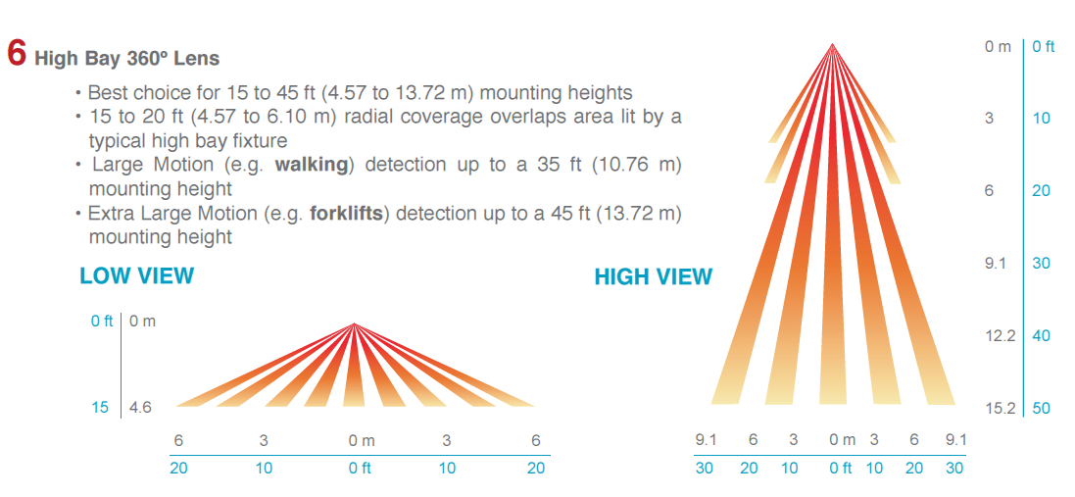
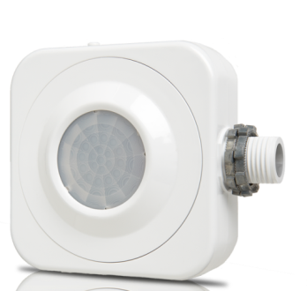
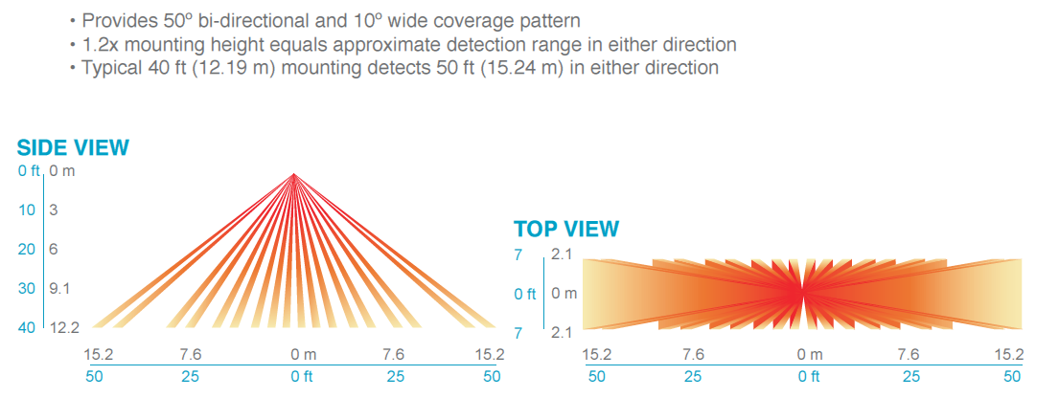
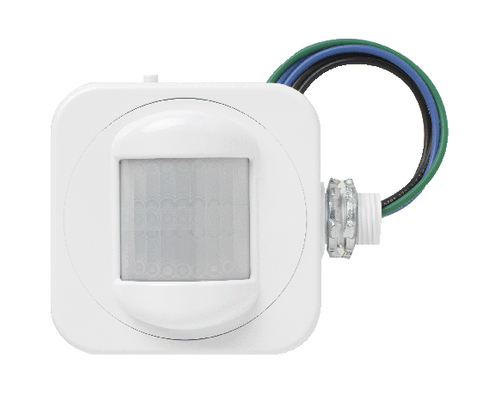
Choose the appropriate control for the application…
High Bay 360°
High Bay Sensor
High Bay Bi-Directional Aisleway Lens
Aisleway Sensor
Notes:
These are common sensors that can mount on any LED luminaire. Don’t need just on/off. More common is to dim down to 50% and leave on as people are more comfortable with some light than simply on/off. 50% reduction is better thank no reduction.

Slide 31
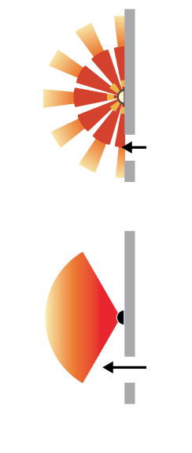
Outdoor Motion Sensing Strategy
Coverage Patterns - Sensor coverage area should match luminaire
Example 1: Wall Sconce Application
~120° Coverage
180° Coverage
VS.
Motion not detected for several feet when approaching from an exit door
Detection occurs much earlier when approaching from side
Notes:
Match your sensor pattern to the application. Beam must be crossed to be tripped. NOT right toward to sensor but across the sensor beam.
31

Slide 32


Outdoor Motion Sensing Strategy
Example 2: Parking Garage Application
Brand | Coverage (radius)
A | 30 ft
B | 25 ft
C | 10 ft
D | 20 ft
  *Note all specs for ~10 ft mounting height
Notes:
Don’t assume all the sensors are the same. Just like lights, tradeoff need to be made. Will Sensor C meet your needs?
32

Slide 33
Lighting Controls
Notes:
Beyond luminaire sensors, Lighting Controls Optimize Efficiency

Slide 34

Outdoor Motion Sensing Strategy
Operation – Motion Control
Notes:
Optional Turn-Off functionality from motion
Ramps down slowly so that lights will not change suddenly if people are present but not active in the space
Fixture fades down to LOW level so as not to distract persons viewing space from outside the sensors viewing area
Digital Push-button programming – requires no tools or accessories
34

Slide 35


Indoor Lighting Controls
Notes:
Your choices are really wired (low voltage) or wireless.

Slide 36

Wired Lighting Controls
…more intelligent than you thought.
Notes:
Even though it’s wired, they can be tuned to listen to different channels through the low voltage wiring.

Slide 37

Wireless Lighting Controls
Notes:
It really isn’t Wireless lighting, we still need power, but more to the point it is wireless communications to control the lighting....or Wireless Lighting Controls.

Slide 38
ISM Unlicensed Bands
The industrial, scientific, and medical radio band (ISM band) refers to a group of radio bands or parts of the radio spectrum that are internationally reserved for the use of radio frequency (RF) energy intended for scientific, medical and industrial requirements rather than for communications.
A Band is a range of frequency space containing multiple channels
26MHz
83.5MHz
150MHz
Industrial
Scientific
Medical
902 – 928 MHz 2.4 – 2.4835 GHz 5.725 – 5.875GHz
Indoor
Hub and spoke
Lighting Contols
Indoor Mesh
Lighting Control
Indoor
Hub and spoke
Lighting Controls
Outdoor Mesh
Lighting Controls
Notes:
All manufacturer need to choose from the ISM unlicensed bands available. Different frequencies offer advantages. 900MHz is slower (2-3 Mbps) shorter distances, can penetrate better. 2.4MHz transmit data faster (up to 11Mbps), longer range, needs line of sight farther than several hundred yards. Everyone needs to pick from one of these.

Slide 39


Slide 40

Jay Marshall, LC
Jay Marshall, LC
Principal Designer, ON2 Solutions
20+ Years Experience
Lighting Certified (LC)
Past President of the Illuminating Engineering Society of NA – Fresno CA
ON2 Solutions offers comprehensive services in all aspects of lighting; from concept to completion.
We specialize in providing quality, energy efficient, and sustainable lighting solutions to our customers. Our services include innovative design, detailed energy and economic analyses, and proven project management.

Slide 41
Right results, the Right way.

Slide 42



Slide 43
Lighting Design Objectives
Light Quantity
Light Quality
Define the Space
Lighting Controls
Notes:
Defining or the space
Introducing Science and Art
Education
Lighting Application
Research-based Practice / Experience
Quantity of Light
Quality of Light
Lighting Controls
Optimize Efficiency

Slide 44


What are your lighting objectives?
Energy Conservation?
Qualitative Improvements?
Quantitative Improvements?
Lighting Software Analysis
IESNA Handbook 10th Edition
Notes:
IES has recommended light levels for various tasks. Lighting software can predict the outcome prior to installation

Slide 45
Define the Space
Notes:
Defining or the space
Introducing Science and Art
Education
Lighting Application
Research-based Practice / Experience
Quantity of Light
Quality of Light
Lighting Controls
Optimize Efficiency

Slide 46


Slide 47


Slide 48

Introducing light into a space matters.

Slide 49
Fitted Target Efficacy (FTE)
π/4 =
78% Coverage
(π/2)-1 =
157% Coverage
100% Coverage
Source: United States Department of Energy
Notes:
Patented technology for square distributions. The square distribution allows fixture and lamp manufacturers to create lighting designs that were previously impossible.

Slide 50




Slide 51

How well does the luminaire distribute light to the task?

Slide 52




Slide 53

Notes:
up to 12% uplight. Point out the scalloping on the A slide and how dark the front of the racks are compared to the smooth/volumetric lighting shown on the B slide.

Slide 54


Is Vertical Illumination Important?
Luminaire A
Luminaire B

Slide 55


Parabolic
Volumetric
Images: Courtesy of Acuity Brands Lighting

Slide 56
Light Quantity
Notes:
Defining or the space
Introducing Science and Art
Education
Lighting Application
Research-based Practice / Experience
Quantity of Light
Quality of Light
Lighting Controls
Optimize Efficiency

Slide 57



Slide 58



137 Watts
131 Watts

Slide 59
Light Quality
Notes:
Defining or the space
Introducing Science and Art
Education
Lighting Application
Research-based Practice / Experience
Quantity of Light
Quality of Light
Lighting Controls
Optimize Efficiency

Slide 60



Slide 62
Lighting Controls
Notes:
Lighting Controls
Optimize Efficiency

Slide 63



Slide 64


Slide 65


Slide 66

Notes:
So an LED luminaire solution, when properly applied, does indeed deliver better illumination for living – by delivering superior performance and significant energy savings. But while I’m on the subject of energy savings, its worth taking this example one step further by adding in the benefit of a bi-level control.
When we add the bi-level control with Part Night capability, we are able to shut off one half of the light engines automatically, half way through the nights. This is a tremendous solution because, like in the parking lot in this image, we can save another 50% energy in the back part of this parking lot – the area furthest away from the buildings – half way through the evening, when no one will park in this area.
If we applied this technology across the entire parking lot, we could save another 33% in energy consumption atop the savings that the LED provides.

Slide 67

Notes:
How much is too much or too little?

Slide 68


Slide 69
System Performance Characteristics
Lumen Output
Initial v Maintained
Wattage Consumption
Optics
System Efficiency
Life Expectancy
Controls Integration
Color Rendering Index
Correlated Color Temperature
Cost
Initial versus Life-cycle
Installation and Maintenance
Product Availability and Service

Slide 70
LEDs (Light Emitting Diodes)
  Manufacturer
  Performance Characteristics
Electronics
  Transient Voltage Surge Suppression
  Driver Case Temperature Rating
Thermal Management
  Passive versus Active Cooling
Mechanical
  IP Rating, Ambient Temperature Rating (- 40°C or 40°C)
Optics
  Photometrics
Controls
  Type of Controls
  System Compatibility
  Wireless versus Wired

